Slide 1

Chapter 7 Retrieval Models
SEG301m

Slide 2
Objectives
Several type of retrievals
Probabilistic models used as retrieval models
How to rank a document/web based on language model
What is web search
The relation between machine learning and information retrieval

Slide 3
Contents
7.1 Boolen retrieval, Proximity Ranking and vector space model
7.2 Probabilistic models
7.3 Ranking based on Language models
7.4 Complex queries and combining evidence
7.5 Web search
7.6 Machine learning and information retrieval
7.7 Application-based models

Slide 4
7.1 Boolen retrieval and vector space model: Boolen retrieval
Exact-match retrieval since documents are retrieved if they exactly match the query specifcation, and otherwise are not retrieved
Not generally described as a ranking algorithm
Two possible outcomes for query evaluation (TRUE and FALSE)
Using operators from Boolean logic (AND, OR, NOT)

Slide 5
7.1 Boolen retrieval and vector space model: Boolen retrieval
Advantages:
Results of the model are very predictable and easy to explain to users
More efficient than ranked retrieval because documents can be rapidly eliminated from consideration in the scoring process
Disadvantages:
Lack of a sophisticated ranking algorithm, simple queries will not work well
Construct complex Boolean: difficult task requires considerable experience

Slide 6


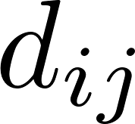
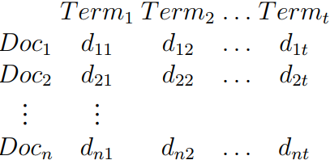
7.1 Boolen retrieval and vector space model: vector space model
A document is represented by a vector of index terms:
where represents the weight of the jth term
A document collection containing n documents:

Slide 7
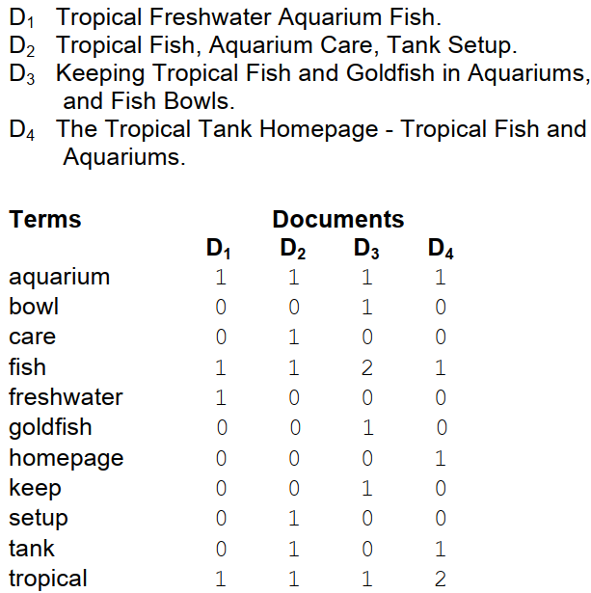
7.1 Boolen retrieval and vector space model: vector space model

Slide 8
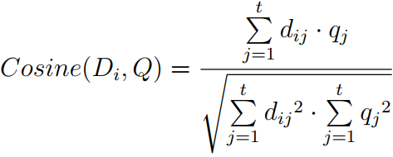

7.1 Boolen retrieval and vector space model: vector space model
Similarity measure
where Q is query vector with weights

Slide 9

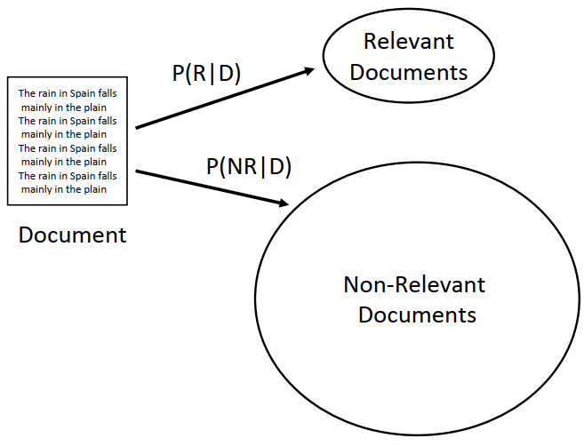

7.2 Probabilistic models: Information Retrieval as Classification
Classify a document as relevant if P(D|R)P(R) > P(D|NR)P(NR) or
pi is the probability that term i occurs

Slide 10



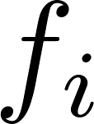
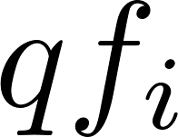
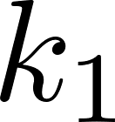
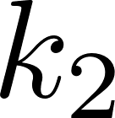
7.2 Probabilistic models: The BM25 Ranking Algorithm
BM25 extends the scoring function for the binary independence model to include document and query term weights.
where N: number of documents, R: relevant documents, : ith non-relevant document, and : ith relevant document, with the additional condition that r and R are set to zero if there is no relevance information, is the frequency of term i in the document; is the frequency of term i in the query; , , and K are parameters whose values are set empirically

Slide 11
7.3 Ranking based on Language models
Language models are used to represent text: speech recognition, machine translation, and handwriting recognition
Simplest form is unigram language model: probability distribution over the words
Topic model for short, contains probabilities for all words, not just the most important
Text is modeled as a finite sequence of words: multinomial distribution over words

Slide 12



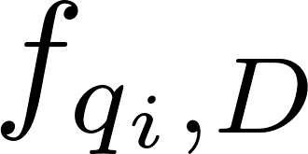
7.3 Ranking based on Language models: Query Likelihood Ranking
Rank documents by the probability that the query text could be generated by the document language model
Unigram language model for the document
where
is the number of times word qi occurs in document D, and |D| is
the number of words in D

Slide 13
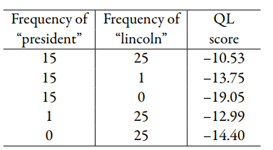
7.3 Ranking based on Language models: Query Likelihood Ranking
The document containing 15 occurrences of “president” and 1 of “lincoln” is ranked higher than the document containing 0 occurrences of “president” and 25 occurrences of “lincoln” in the QL scores

Slide 14
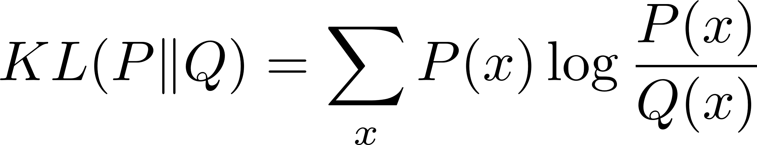


7.3 Ranking based on Language models: Relevance Models and Pseudo-Relevance Feedback
Disadvantage of basic query likelihood model?
limited in terms of how it models information needs and queries
Kullback-Leibler divergence
True distribution to be the relevance model for the query (R) and the approximation to be the document language model (D), then the negative KL-divergence can be expressed as
The score for a document

Slide 15
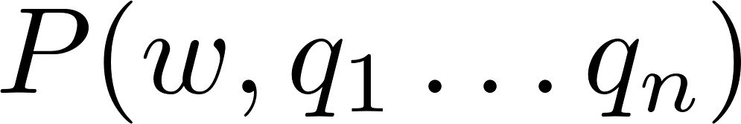

7.3 Ranking based on Language models: Relevance Models and Pseudo-Relevance Feedback
1. Rank documents using the query likelihood score for query Q. 2. Select some number of the top-ranked documents to be the set C. 3. Calculate the relevance model probabilities P(w|R) using the estimate for 4. Rank documents again using the KL-divergence score:

Slide 16
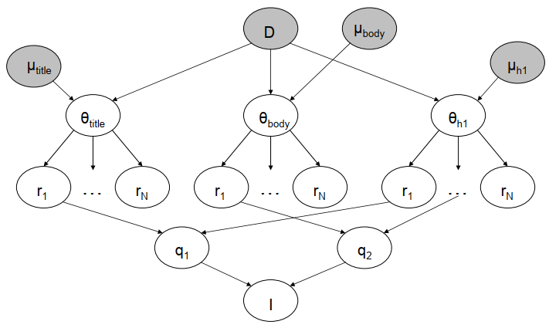
7.4 Complex queries and combining evidence: The Inference Network Model
Example: calculate P(I|D,µ) → probability that an information need is met given the document and the parameters µ

Slide 17
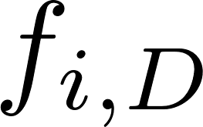

7.4 Complex queries and combining evidence: The Inference Network Model
is the number of times feature ri occurs in document D, P(ri|C) is the collection probability for feature ri, and µ is the Dirichlet smoothing parameter

Slide 18
7.4 Complex queries and combining evidence: The Galago Query Language
Galago query language presented here is similar to query languages used in open source search engines that are based on the inference network retrieval model.
Galago query language, a document is viewed as a sequence of text that may contain arbitrary tags

Slide 19
7.5 Web Search
The most important search application.
Millions of people use web search engines every day
Major differences between web search and an application that provides search for a collection of news stories
Different types of search in a web environment
Informational: goal of finding information about some topic that may be on one or more web pages
Navigational: goal of finding a particular web page that the user has either seen before or assumes must exist
Transactional: goal of finding a site where a task such as shopping or downloading music can be performed

Slide 20
7.5 Web Search
Commercial web search engines incorporate hundreds of features
The relative importance of these features and how they can be manipulated to obtain better search rankings for a web page is the basis of search engine optimization (SEO)

Slide 21

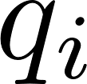
7.6 Machine learning and information retrieval: Learning to Rank
All of the probabilistic retrieval models presented so far fall into the category of generative models
A discriminative model, in contrast, estimates the probability of belonging to a class directly from the observed features of the document based on the training data
The well-known of the approaches used to learn a ranking function for search is based on the Support Vector Machine (SVM) classifier with input:
is a query and is partial information about the desired ranking, or relevance level, of documents for that query

Slide 22

7.6 Machine learning and information retrieval: Topic Models and Vocabulary Mismatch
Latent Semantic Indexing : maps documents and terms into a reduced dimensionality space, so that documents that were previously indexed using a vocabulary of hundreds of thousands of words are now represented using just a few hundred features
Latent Dirichlet Allocation: models documents as a mixture of topics
For each document D, pick a multinomial distribution from a Dirichlet distribution with parameter α.
For each word position in document D: a) Pick a topic z from the multinomial distribution . b) Choose a word w from P (w|z, β), a multinomial probability conditioned on the topic z with parameter β

Slide 23
7.7 Application-based models
Customizing a ranking algorithm for the application will nearly always produce the best results
First step in doing this is to construct a test collection of queries, documents, and relevance judgments so that different versions of the ranking algorithm can be compared quantitatively
Next step is to identify what evidence or features might be used to represent documents

Slide 24
Exercise
As a class project, undertake a TREC-style adhoc retrieval experiment, developing a test collection based on Wikipedia
Implement the BM25 ranking formula. Test your implementation using the test collection developed
Implement the term selection step of the pseudo-relevance feedback method

Slide 25
Summary
Boolen retrieval, Proximity Ranking and vector space model
Probabilistic models: Information retrieval as classification, BM25 Ranking Algorithm
Ranking based on Language models: Query likelihood ranking, relevance models and pseudo- relevance feedback
Complex queries and combining evidence: The inference Network model, the Galago Query Language
Web search
Machine learning and information retrieval: learning to rank. Topic models and vocabulary mismatch
Application-based models

